Slide 1
JVM, JRE, and JDK

Slide 2
Agenda
Java Program - Life Cycle
Platform Inclusion
Tools
JDK
JRE
JVM

Slide 3
Java Program - Life Cycle
A Java Program is written
Using source code editors (Eclipse, IntelliJ, notepad, etc..)
Extension is “.java”
The Java Program is compiled
Using Java compiler
Extension is “.class”
The Java Program is executed (“run”)
Using Java runner or a JVM

Slide 4
Java Program - Platform Inclusion
A Java Program is written in Windows
The Java Program is compiled in Windows
The (same) Java Program can be executed (“run”)
Windows
Unix
Linux
Mac

Slide 5
Java Program - Tool Inclusion
Java Program Compilation
Name of the compiler is “javac”
Part of JDK
Java Program Execution
Name of the executioner or (“runner”) is “java” or JVM
Part of JRE

Slide 6
JDK
Acronym for Java Development Kit
Environment to develop and run java programs
Comprises of
Development / Run Tools
JRE
“To develop”
Compiler, Debugger, Profiler, etc…
“To run”
Java (JVM), Jar, etc…

Slide 7
JRE
Stands for Java Runtime Environment
Can be used to
Run Java Program
Running a java program creates a JVM
Combines the following
JVM
Supporting Libraries

Slide 8
JVM
Stands for Java Virtual Machine
It's not a physical machine
A virtual machine that knows how to take in the bytecode and converts to OS specific instructions
Windows Machine
That knows how to read and execute Windows specific codes / instructions
JVMs are different for different hardware and software platform

Slide 9
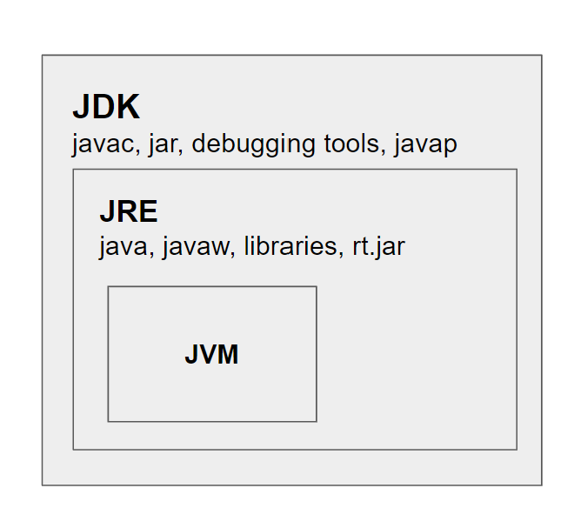
JDK, JRE and JVM

Slide 10
Summary
Lifecycle of a Java Program
JDK comprises of JRE and development toolkit
JRE is a software package that holds component required for successful execution of codes
JVM converts the compiled byte code into OS specific code/instructions

